Slide 1


Free pizza & beer.... and other mistakes
Andy Mallon he/him
am2.co/free-pizza

Slide 2

Andy Mallon
I sell furniture at the mall
Database Architect at Wayfair.com*
Working with SQL Server since the turn of the century
Background in Tech Support, Database Administration, and Database Architecture
Lazy
Impatient
* The views & opinions expressed in this presentation are mine alone and do not reflect the views of my employer.

Slide 3
About me
Unabashedly queer
I hate racism, homophobia, bigotry, and news websites that require disabling my ad blocker
I love inclusive communities, helping others, dogs, and oxford commas

Slide 4
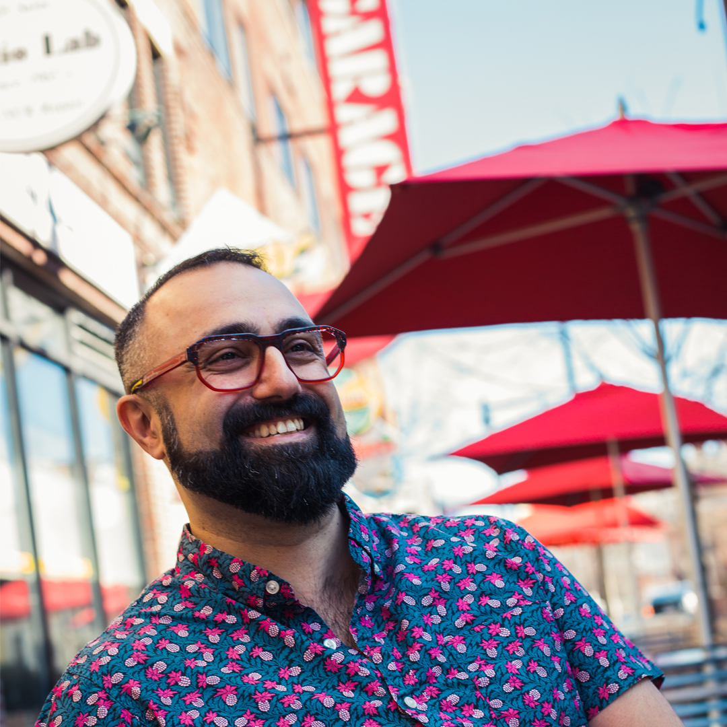
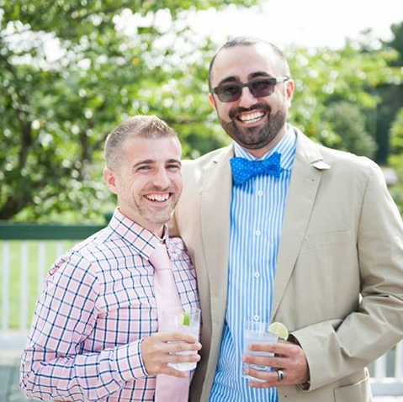
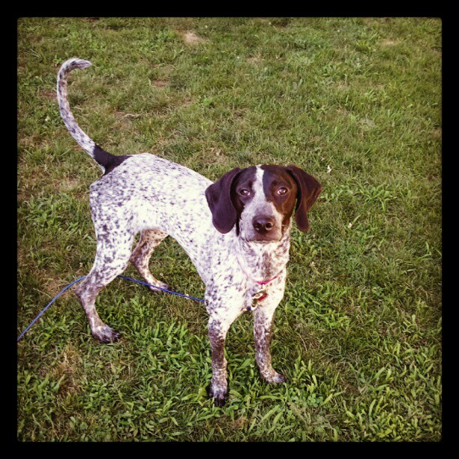
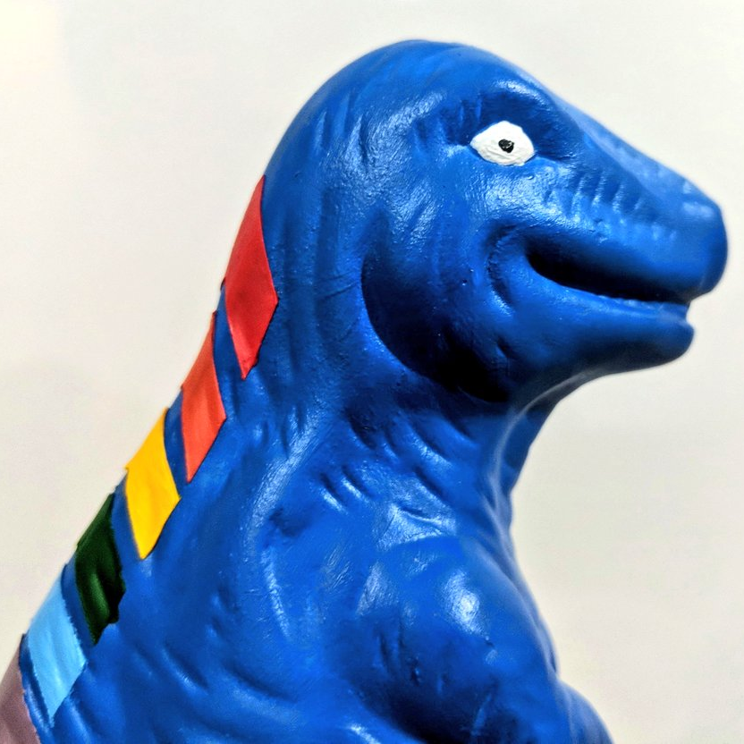
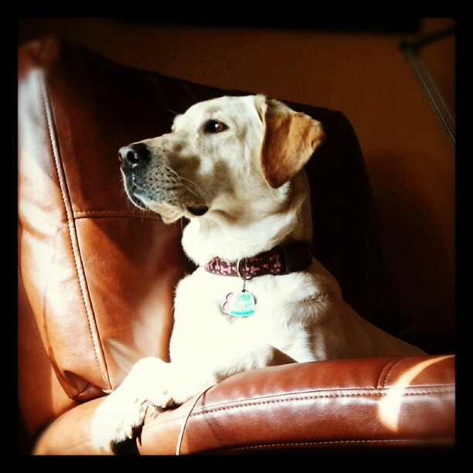

Notes:
Some of the things I love most in life– My husband, my pups, Queery the Diversity Dino.

Slide 5
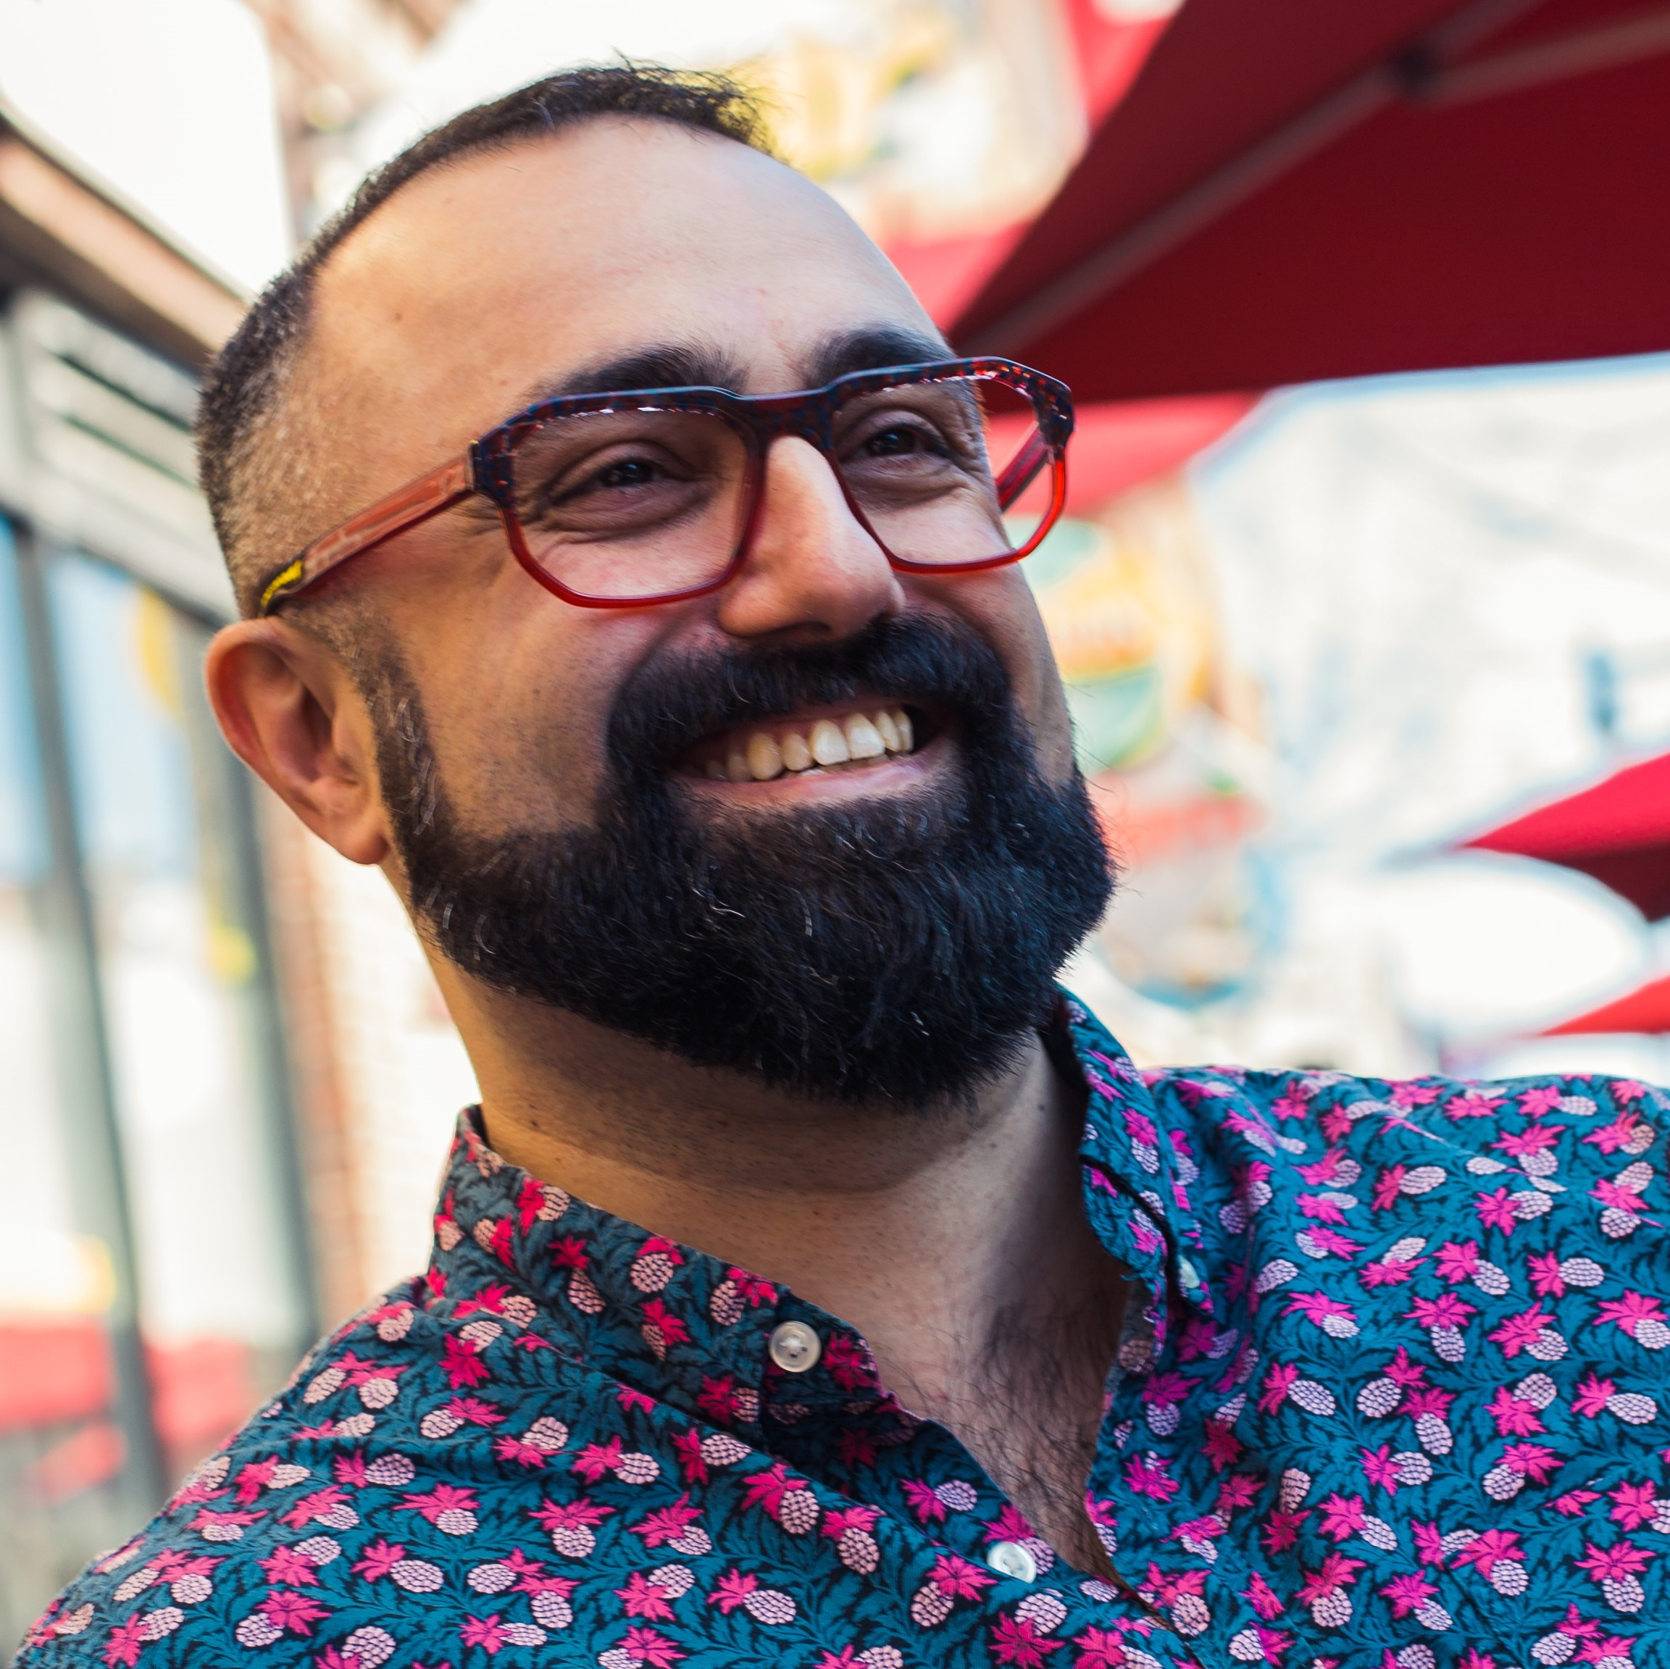


Contact Andy
Andy@AMtwo.co
@AMtwo
Go to menti.com and use code 94 55 717
andy@am2.co

Slide 6

Session Feedback
Tell me what you don’t like
Tell me what can be better
Tell me what you like

Slide 7


Yea…….You apparently didn’t put one of the new coversheets on your TPS reports.
I'm also gonna need you to go ahead and silence your phones and devices

Slide 8
Questions…
Go to menti.com
Use code 94 55 717
Answer three questions for me
Ask me anything
I’ll blog responses at am2.co

Slide 9
Thank you GroupBy
…for the opportunity to be here
…for building a welcoming & inclusive community
…for prioritizing sessions like this
…for “walking the walk” and not just “talking the talk”

Slide 10
Agenda
Learn some jargon
Diversity & inclusion are important
Starting at “diversity” is the wrong approach
Welcoming & Belonging
Equity & Inclusion
Tell some stories
My personal experiences as a queer man
Notes:
Its easier to understand the jargon than it is to define it
We mostly know it’s important… so lets talk about how it affects individuals
We often don’t consider tech content credible unless it’s told by someone who has experience on the front lines. Well, I’m sharing my front-lines experience here today

Slide 11
Goals
Listen
Be humble
No one here knows everything
No one here is perfect
Bring our whole self to the GroupBy community
Help others bring their whole self

Slide 12
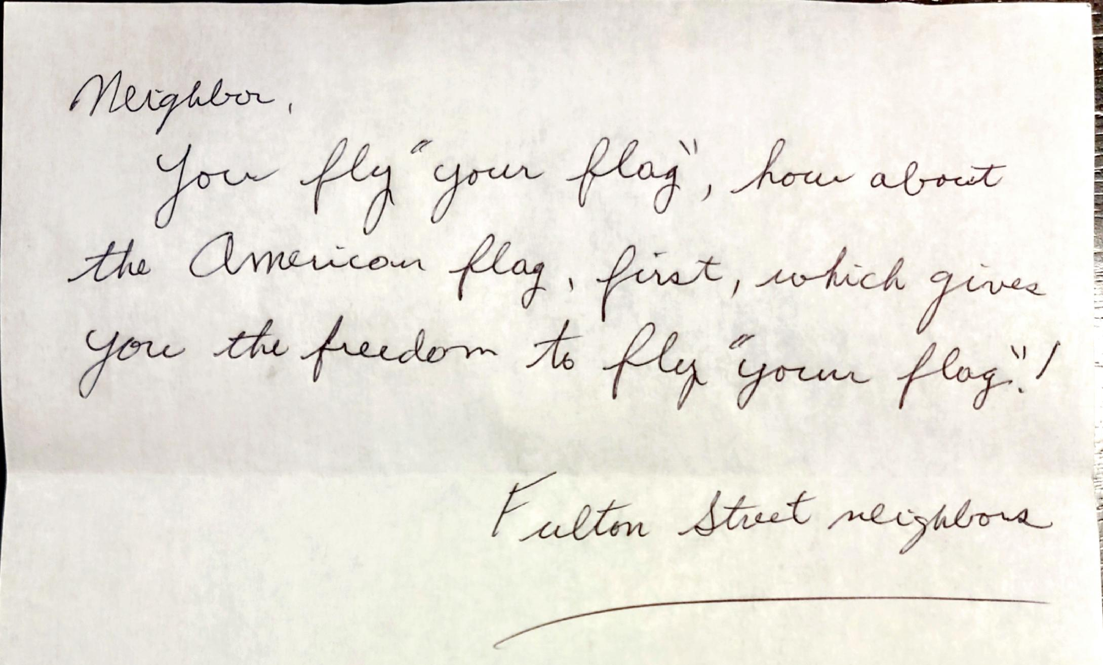
Let’s start with a story

Slide 13
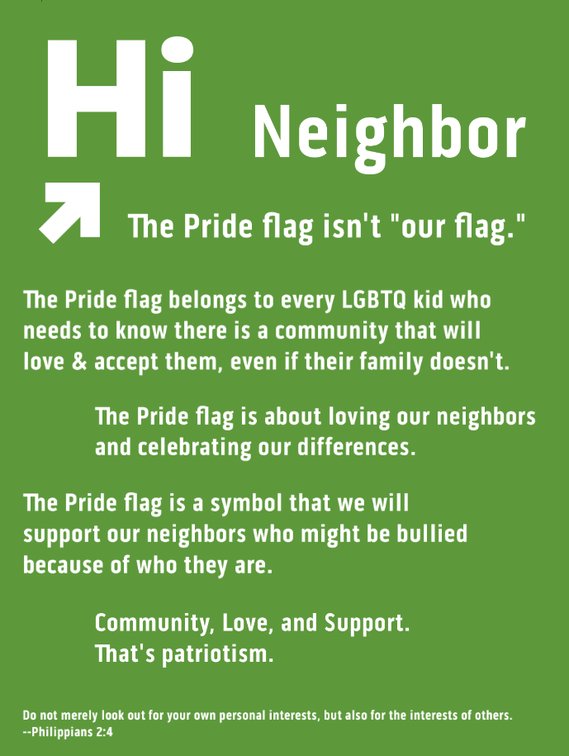
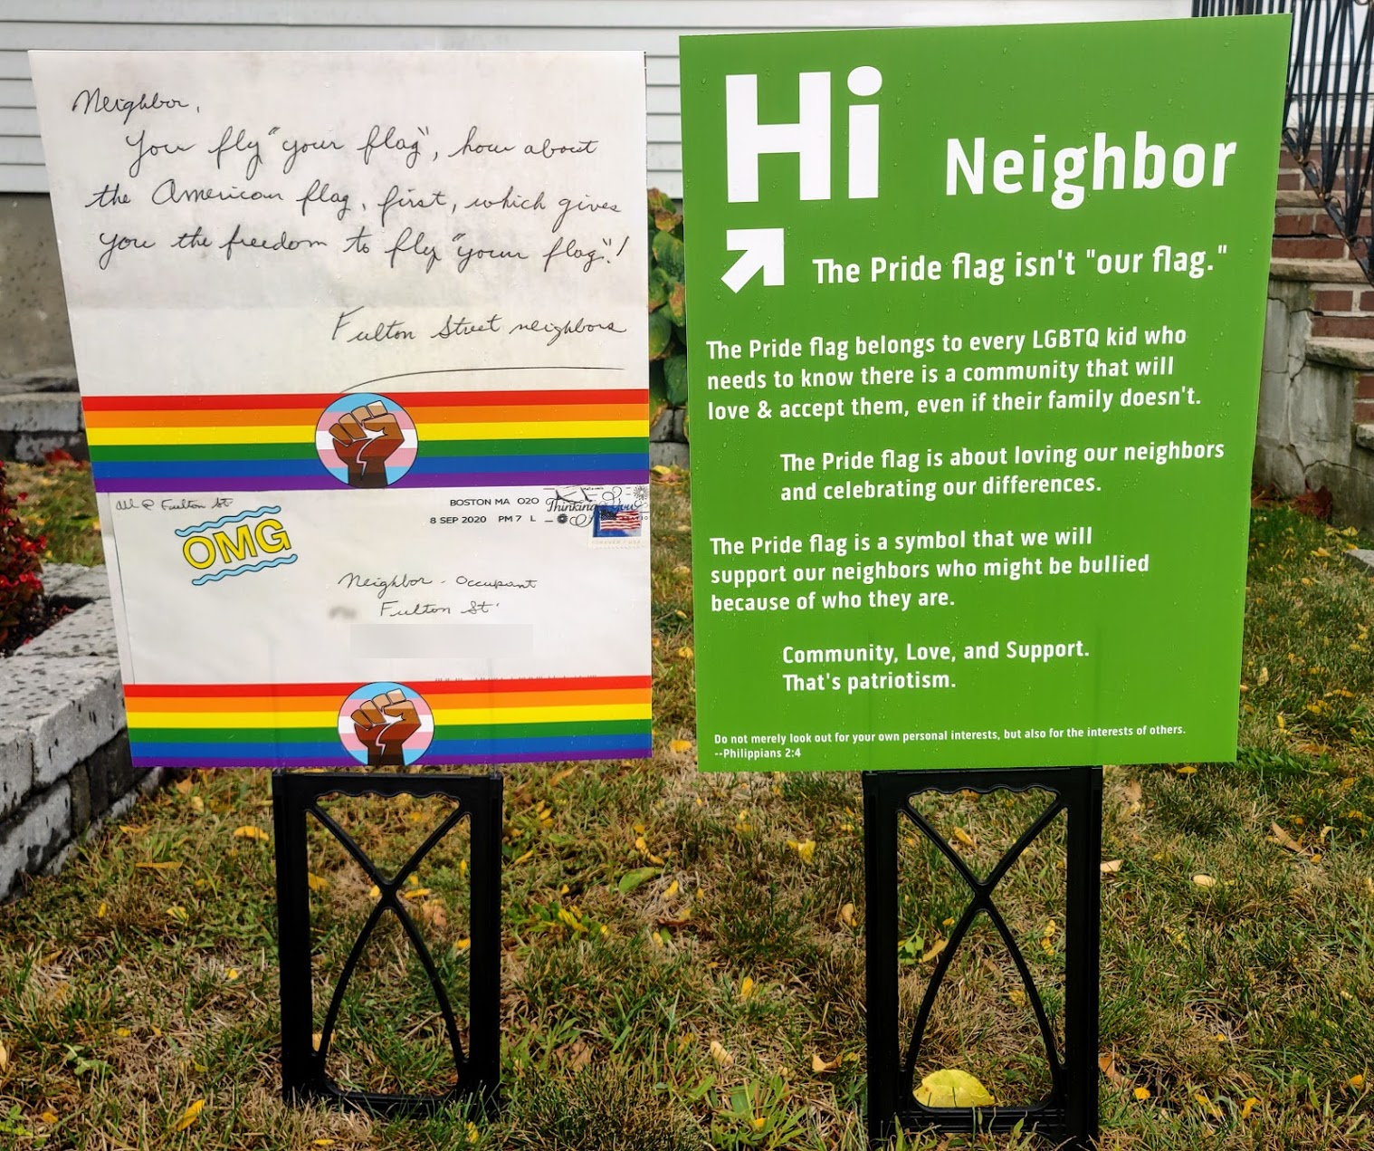
Hi Neighbor!

Slide 14
Allyship
Do not merely look out for your own personal interests, but also for the interests of others.
--Philippians 2:4

Slide 15
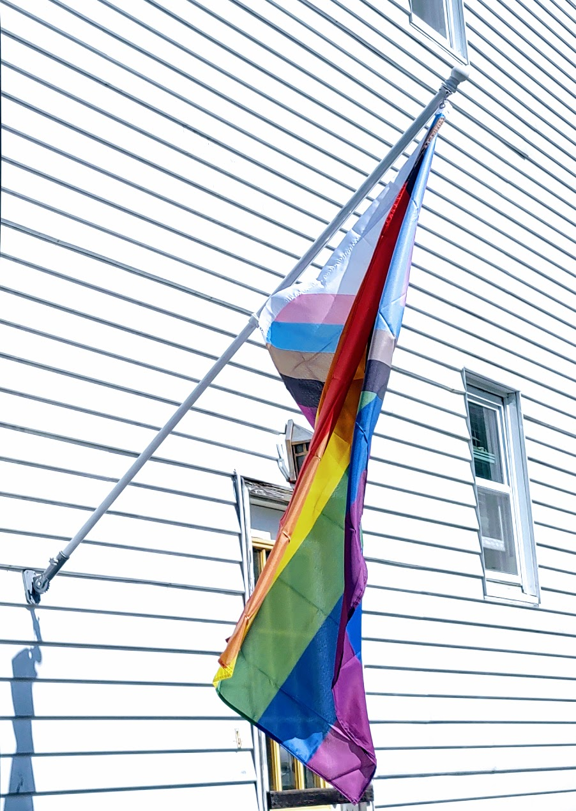
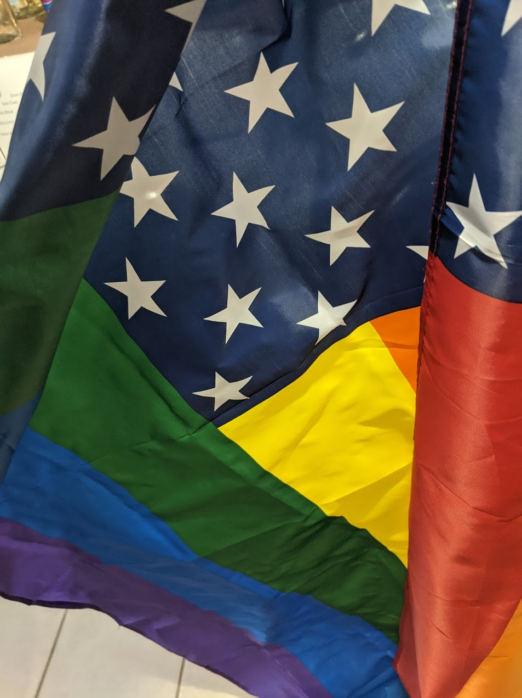

What is the Pride Flag?

Slide 16
I don’t know the intent…
…But it is bullying
It tells me I can’t celebrate who I am
It discourages me from being an ally for others in my own community
Does celebrating the LGBTQ community mean I should be unwelcome in my neighborhood community?

Slide 17
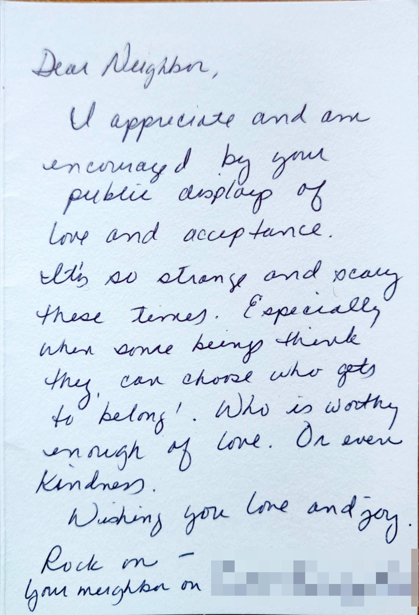
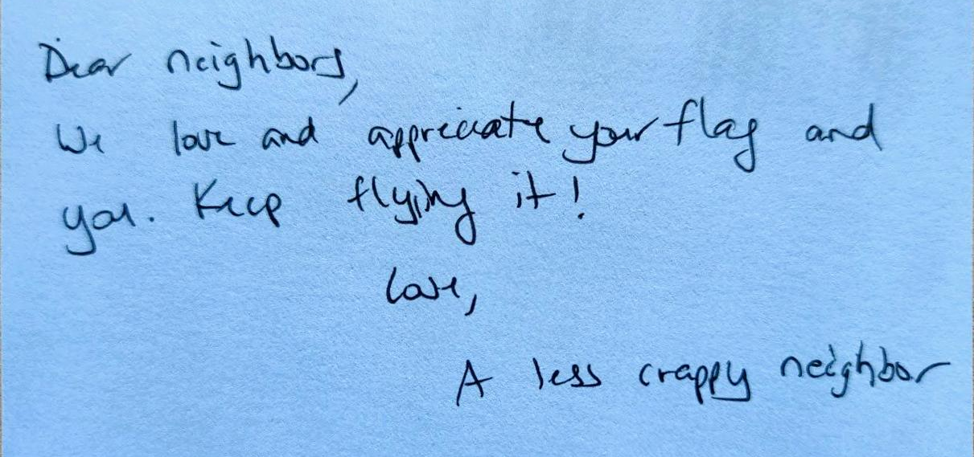
More letters…

Slide 18
Why did I tell this story?
Intersecting communities is intersectionality
Otherness / Othering
Belonging
Allyship

Slide 19
Community
The SQL Server community
The GroupBy community
Your employer is a community
Your neighborhood is a community
Your church is a community
Your country is a community
Notes:
LGBTQ Community
Communities built around shared medical conditions
“Survivor” communities around diseases & events
Communities built around disabilities and different abilities

Slide 20
Community is built around
where we live
who we are
what we do
what we look like
interests & hobbies
etc etc etc etc

Slide 21
Jargon
Diversity
Equity
Inclusion
Intersectionality
Belonging

Slide 22
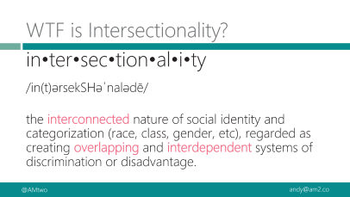
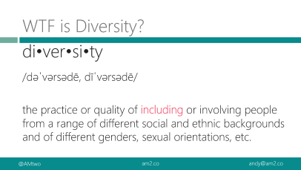
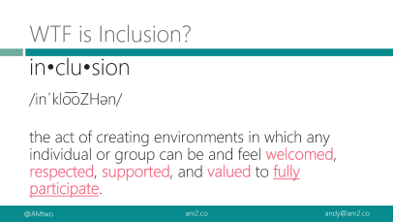
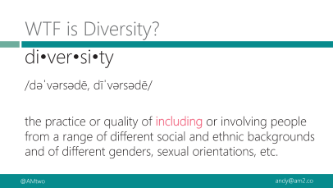
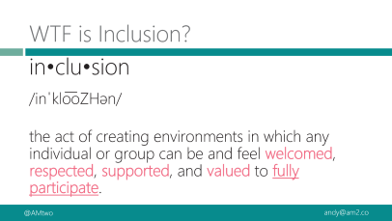
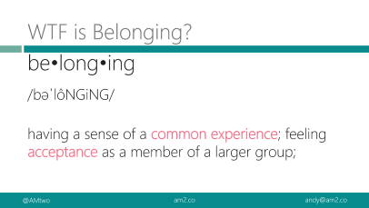
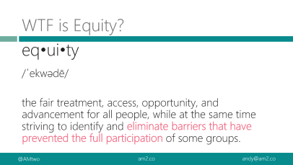

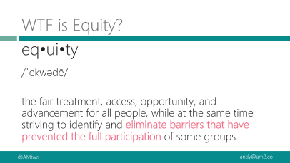
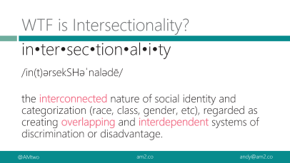
Definitions aren’t exciting
we are not going to read definitions today
Download the slides if you prefer a formal vocabulary lesson

Slide 23
WTF is Diversity?
di•ver•si•ty
/dəˈvərsədē, dīˈvərsədē/
the practice or quality of including or involving people from a range of different social and ethnic backgrounds and of different genders, sexual orientations, etc.

Slide 24
WTF is Equity?
eq•ui•ty
/ˈekwədē/
the fair treatment, access, opportunity, and advancement for all people, while at the same time striving to identify and eliminate barriers that have prevented the full participation of some groups.
Notes:
Improving equity involves increasing justice and fairness within the procedures and processes of institutions or systems, as well as in their distribution of resources.

Slide 25
WTF is Inclusion?
in•clu•sion
/inˈklo͞oZHən/
the act of creating environments in which any individual or group can be and feel welcomed, respected, supported, and valued to fully participate.
Notes:
An inclusive and welcoming climate embraces differences and offers respect in words and actions for all people.
Diverse environments that are not inclusive aren’t helpful---it’s just a gathering of “tokens”

Slide 26
WTF is Intersectionality?
in•ter•sec•tion•al•i•ty
/in(t)ərsekSHəˈnalədē/
the interconnected nature of social identity and categorization (race, class, gender, etc), regarded as creating overlapping and interdependent systems of discrimination or disadvantage.
Notes:
Intersectionality takes into account people’s overlapping identities and experiences in order to understand the complexity of prejudices they face.

Slide 27
WTF is Belonging?
be•long•ing
/bəˈlôNGiNG/
having a sense of a common experience; feeling acceptance as a member of a larger group;
Notes:
A sense of belonging is something we all feel & know, but it’s hard to define A sense of belonging to a greater community improves your motivation, health, and happiness. When you see your connection to others, you know that all people struggle and have difficult times. You are not alone. There is comfort in that knowledge.

Slide 28
Less boring definitions
Diversity is having a seat at the table, inclusion is having a voice, and belonging is having that voice be heard.
~ Liz Fosslien and Mollie West Duffy (lizandmollie.com)

Slide 29
My definitions
Diversity is “people who don’t look or live like you”
Inclusion is “the ability to your whole self”
Belonging is “feeling a part of something, not feeling apart”
Notes:
Inclusion means bringing your whole self—including the parts that make you different & diverse.
Belonging is being comfortable when you do bring that whole self.

Slide 30
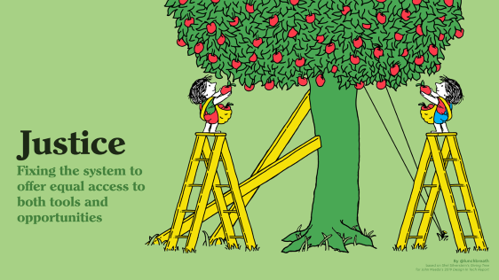
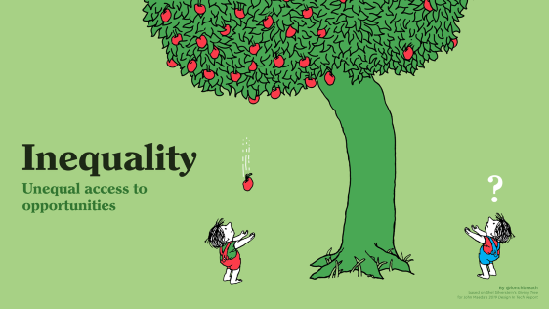
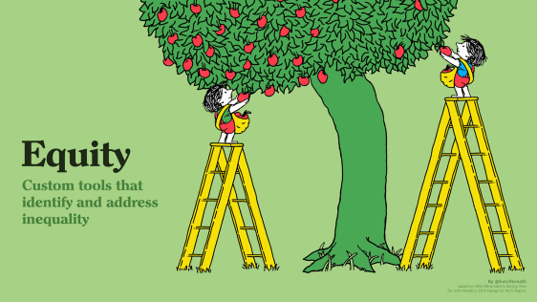
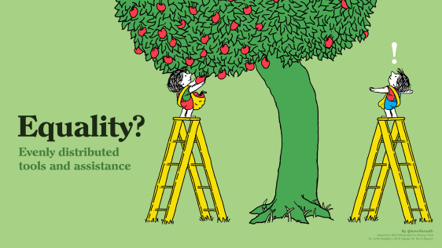

Slide 31

Notes:
1/ Inequality means being born on the wrong side of the tree versus the better side.

Slide 32
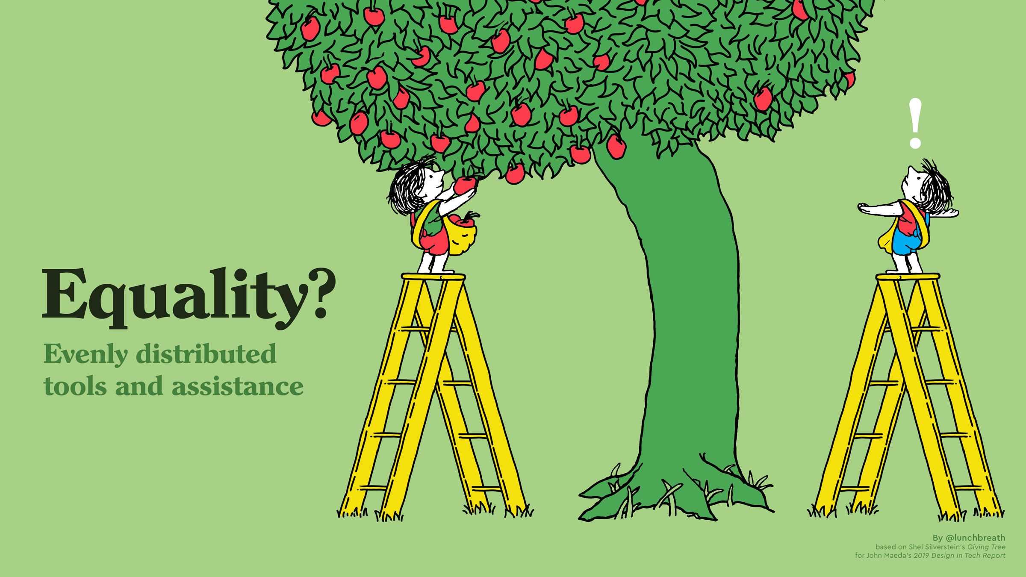
Notes:
2/ Equality means trying to reconcile equity by giving an equal solution to both.

Slide 33

Notes:
3/ Equity means knowing that there’s a right-sized solution to each individual.

Slide 34

Notes:
4/ Justice means working to correct the system itself — e.g. tackling systemic racism.

Slide 35
Allyship
If underrepresented, or underprivileged folks could achieve justice on their own, they would have done it by now
Overcoming injustice single-handedly is hard
My husband can’t reach the top shelf without me
Notes:
Do you think women really like being paid 81% of what men make? Do queer folks like being teased & taunted?

Slide 36
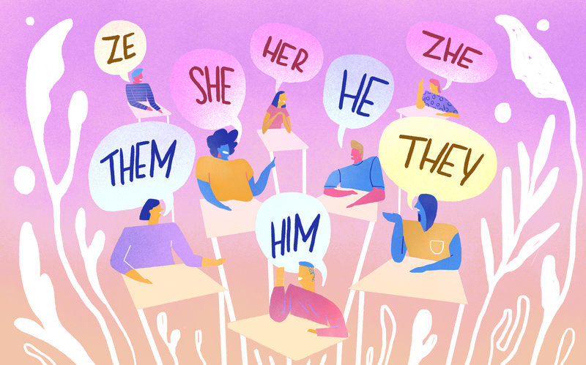
Why Pronouns matter
A very simple act of allyship
Allyship is the “good” side of or opposite of peer pressure
Notes:
I don’t need to do it. Doing it is no big deal for me. A simple act for me, can normalize it and make it much easier for someone else, who would be uncomfortable if they had to share their pronouns, and was the only one.

Slide 37
Simple acts
Sometimes the simple acts are the ones that matter most
Your conduct is important to creating an inclusive community

Slide 38
Be welcoming
I can’t bring my whole self to a community if I’m being “told” I’m not welcome there
Actions speak louder than words in telling me
Words, actions, and culture all contribute to an environment being welcoming or not
Be mindful of what you do and say
Be comfortable that you’ll sometimes do the wrong thing

Slide 39
Codes of Conduct
Help underrepresented groups feel included
What conduct is expected from everyone
Tell folks where to turn when someone is unkind, unwelcoming, or abusive
Tell folks what to expect from a response
Provides a system of “justice”

Slide 40
The Quick Version
We are dedicated to a harassment-free experience for everyone, regardless of who you are and what makes you you. We recognize the right of any individual to attend and participate. Anyone. This is included but not limited to gender identity and expression, sexual orientation, disability, physical appearance, body size, race, religion, or any other classification, affiliation, or label.
We do not tolerate harassment in any form. For the duration of your engagement with GroupBy and its programs, you are expected to act appropriately and to adhere to this Code of Conduct. This includes conduct in-person and online, at the conference itself, as well as any non-conference programs that may include participants: including talks, workshops, parties, on social media, and other online forums. GroupBy participants violating these rules may be sanctioned or expelled without a refund (if that applies) at the discretion of the conference organizers.
You can review the full policy at: GroupBy.org/Code-of-Conduct
Notes:
You do not need to read this full policy, just give people time to read this and explain they can review the full policy at the provided link.

Slide 41
We are dedicated to a harassment-free experience for everyone, regardless of who you are and what makes you you. We recognize the right of any individual to attend and participate. Anyone.
Notes:
You do not need to read this full policy, just give people time to read this and explain they can review the full policy at the provided link.

Slide 42


Difficult conversations

Slide 43
Story Time
That time I misgendered my friend…
During my session at a conference…
Multiple times

Slide 44
“I f*cked up”
“You aren’t a Senior DBA if you haven’t caused and also fixed a production outage.”
You aren’t fostering inclusion if you haven’t f*cked up, and also admitted it.
Have the conversation
Understand from the other person’s perspective
Notes:
This involves talking about feelings, and actions, and how they affect each other

Slide 45
“I f*cked up”
People don’t know your intent unless you tell them
Don’t get defensive
Ex) Someone says you are racist
Ask why they think that. What actions made them decide that was your motivation
“Accidental racism” is still racism
Find common ground
Clarify intent, pledge to fix actions next time, then do better

Slide 46
“I f*cked up”
Avoid the DARVO response
Deny
Attack
Reverse Victim & Offender
Beware of DARVO response by others
victim blaming

Slide 47
You don’t know everything
Be humble in conversations
Listen to the lived experience of others
Don’t be dismissive
“It feels like the social equivalent of works on my machine” ~Drew Furgiuele
You might not see something happen—that’s not evidence that it doesn’t happen
Notes:
Don’t be dismissive of feelings or experiences
Nothing shuts down a conversation quicker than being dismissive

Slide 48
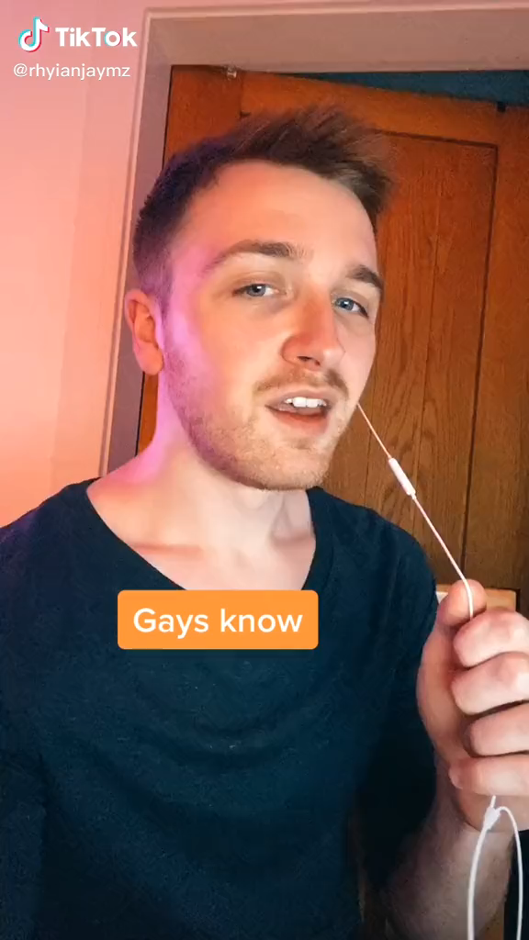
“To be gay is…
…to be recommended holiday destinations by friends and family which you can’t actually go on because being gay is illegal in that country, and if you went you’d probably get beaten, arrested, or something worse.”
Notes:
“Just take a cab home from a bar.” * Will a woman feel safe? * Will a black man even be able to get a taxi?
* If a black woman can get a taxi, will she then feel unsafe in it?

Slide 49
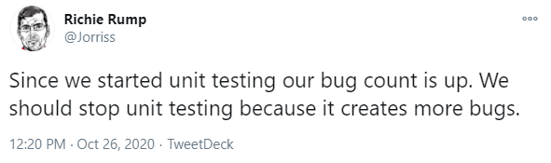
Let’s talk unwelcoming behavior
“Separate but equal” policies
Gatekeeping
Bad faith arguments, like this one:

Slide 50
“Separate but equal” policies
Making Diversity a separate, opt-in experience
Or breaking different groups into “segregated” separate groups
Doesn’t allow space to celebrate intersectionality
Inclusion has to run through the whole org
Top-down & bottom-up

Slide 51
Gatekeeping
“The wrong kind of gay”
“Not Latina enough”
“Not a real DBA”
Forcing people into boxes based on stereotypes
Forces a feeling of otherness

Slide 52
Bad faith arguments
Common bad-faith arguments
“It’s hard to be a white guy in tech, too!”
“She just isn’t trying hard enough”
“If you don’t like what I do, then you should stay home.”

Slide 53
Bad faith arguments
Often, demonstrably false
Force you to argue about minutia
Designed to avoid the real topic
Deflects the problem back to you
Impossible to combat with logic

Slide 54

Story time!
2004-2007 was a battle for marriage equality in Massachusetts
I was very involved in advocating for my future right to marry my husband
We hadn’t met yet

Slide 55
Same-sex marriage
Nov 18, 2003: Goodridge v Dept of Public Health
Feb 11, 2004: Constitutional Convention; amendment moves forward to change the state constitution to ban same-sex marriage
May 17, 2004: 50th anniversary of Brown v Board of Education & first legal same-sex marriage
Sep 24, 2005: 2nd Constitutional Convention; amendment defeated at 11th hour
Jul 12, 2006: 3rd Constitutional Convention; Vote delayed until after the election
Nov 7, 2006: Pro-equality candidates win broadly in elections
Nov 9, 2006: 4th Constitutional Convention; Vote delayed until Jan 2, 2007—the last day before new legislators sworn in
Jan 2, 2007: 5th Constitutional Convention; Amendment moves forward to ban same-sex marriage
Jun 14, 2007: 6th Constitutional Convention; Amendment defeated 151-45, with original sponsor now voting against it
Jul 26, 2012: Massachusetts recognizes that “civil unions” elsewhere are equivalent to marriage.
Jun 26, 2015: Supreme Court of the US rules in Obergefell v Hodges that states must allow same-sex marriage, Federal government to recognize them
Today: Talk of undoing Obergefell

Slide 56
The (bad faith) argument…
“Same-sex marriage degrades the value of my marriage. It says to me that my uniqueness as a man, as a husband, and as a father is irrelevant.” ~Kris Mineau, from Saving Marriage
This is a myopic (and incorrect) worldview that discounts the worth of LGBTQ individuals & their relationships
Notes:
This slide includes an Amazon Affiliate link.
Kris Mineau, was leading an anti-gay organization called the “Massachusetts Family Institute”
What he is actually saying is that LGBTQ folks are irrelevant, that our self-worth is second to his self worth.
This is also gatekeeping. Not everyone’s relationships need to be the same. Different couples have very different ideas of what marriage is

Slide 57
Otherness of “separate but equal”
If “Civil Unions” give the same rights as marriage, isn’t that good enough?
“If we have to say that it’s a civil union, it’s just making us different. If they want to say it’s the same thing, then they should use the same word. We want all the same rights, and we want to be able to use their word, too.” ~Andy Mallon, from Saving Marriage
Notes:
This slide includes an Amazon Affiliate link.

Slide 58
Intersectionality
Religious right tactic was to make it “us vs them”
Forces Christian parents to choose between their gay children & their religious identity
Forces gay Christians to choose between two major self-identities
This is a bad faith argument

Slide 59
WTF CAN I DO?!?

Slide 60
WTF can I do?
It’s not enough to be “not a bigot” you need to be “anti-bigot”
Socially acceptable bigotry changes with time
Keep learning
“We’ve always done it that way” isn’t an excuse

Slide 61
WTF can I do?
Study
Listen
Have humble, constructive, and difficult conversations
Be mindful of words & actions
I could do a whole session on word choice
“That’s a dumb idea” vs “I don’t understand that idea”

Slide 62
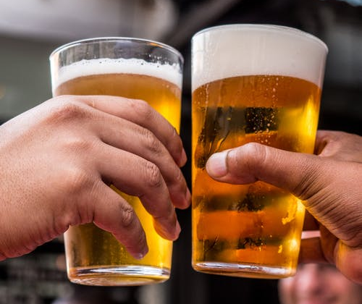
OK, but why are pizza & beer bad?
Everyone likes free pizza & beer, right?

Slide 63
Questions…
Go to menti.com
Use code 94 55 717
Answer three questions for me
Ask me anything
I’ll blog responses at am2.co

Slide 64
Poll Results

Slide 65
More reading
Hi, I’m Andy. My pronouns are he/him.
Racism is our problem to solve
Beyond the DE&I Acronym: What are Diversity, Equity, and Inclusion?
What is intersectionality, and what does it have to do with me?
How can you be more diversity-friendly and inclusive?
The intersectionality wars
Bring your whole self to work (TEDx video)
Long Divisions: The history of racism and exclusion in the United States
singular "they" is here to stay. (video)
Meritocracy prizes achievement above all else, making everyone—even the rich—miserable
Carrie Dragshaw (video)
DARVO response

Slide 66
Be kind to one another
Thank you for coming
am2.co/free-pizza

